Slide 1

Hyperlocal Urban Heat &Vulnerability Mapping and Alert
PROJECT MEMBERS
DEEPIKA B 511522205010
INDUMATHI Y 511522205020
LAKSHANA K 511522205027
THAMIZHILAKKIYA R 511522205054
PROJECT COORDINATOR PROJECT SUPERVISOR
KAMALANATHAN E KAMALANATHAN E
ASSISTANT PROFESSOR & HEAD IN-CHARGE ASSISTANT PROFESSOR & HEAD IN-CHARGE
Dept. of IT. Dept. of IT.

Slide 2
Introduction
Cities are becoming hotter because of buildings, roads, and less trees. This is called the Urban Heat Island effect.
High temperature causes health problems and increases electricity usage.
Existing systems cannot show heat changes in small areas.
This project creates a system to analyze heat at a local level using satellite data and machine learning.
It helps to find heat areas, predict temperature, and give alerts.

Slide 3
Objective
To analyze urban heat patterns at a hyperlocal level using satellite and weather data.
To identify heat hotspot areas within the city using GIS techniques.
To assess vulnerability by mapping high-risk populations exposed to extreme heat.
To develop a heat alert system for early warning in vulnerable zones.
To support urban planning and public health decision-making through heat risk mapping.

Slide 4
Abstract
This project develops a Hyperlocal Urban Heat Vulnerability Mapping and Alert System using satellite data and machine learning.
The system collects temperature and environmental data such as NDVI and NDBI.
A Random Forest model is used to predict temperature for different locations.
The results are shown using heatmaps, which help to identify high-temperature areas. An alert system is included to warn users when temperature exceeds a limit.
The system is built using Streamlit for easy interaction.
This project helps in identifying heat-prone areas and supports better planning and safety.

Slide 5
Literature Review
1 F. Larroya et al 2025 Hyperlocal Urban Heat Mapping 2 3 4 5
SI NO
Author
Year
Title
Description
Gap Identified
Uses satellite and ground data to analyze heat at small areas
No real-time alert system
Uses machine learning to predict temperature and heat patterns
No visualization dashboard
IEEE Access
ML in Heat Mapping
2023
Provides early warning system for extreme heat conditions
No hyperlocal
analysis
WHO
2023
Heat Alert Systems
Uses GIS and remote sensing to identify heat vulnerable areas
No machine learning
prediction
P. Siddiqui et al
2022
GIS Heat Mapping
Sheridan & Kalkstein
Heat Vulnerability Index
Combines environmental and social factors to find risk zones
No real-time monitoring
2022

Slide 6
Existing Model
Most urban heat studies rely on static satellite analysis
Uses only single data source (Landsat or weather data)
No integration of NDVI, NDBI, and ML models
Provides low spatial resolution results
No real-time prediction system
No alert mechanism for extreme heat

Slide 7
Problem Identification
Cities are getting hotter due to buildings and less trees
Existing systems show only overall city temperature
Cannot identify heat in small areas
No proper system to detect vulnerable people
No real-time prediction of temperature
No alert system for extreme heat

Slide 8
Proposed Model
System divides city into small areas Collects data from satellite and weather Uses features: NDVI
NDBI
Time (morning, afternoon, evening)
Year
Uses Machine Learning (Random Forest)
Predicts temperature based on location and time
Shows result in heatmap
Calculates risk level
Gives alerts when temperature is high
Built using Streamlit

Slide 9
Methodology
a) System Flow
Select Location
Select Date & Time
Collect Satellite Data
Extract NDVI & NDBI
Process Data
Predict Temperature (ML Model)
Generate Heatmap
Calculate Risk Level
Display Alert

Slide 10
Methodology
b)Tools & Technologies Used
Python
Streamlit
Google Earth Engine
Scikit-learn
Folium
Pandas

Slide 11
Methodology
c) Implementation Strategy
Phase 1 – Data Collection (Satellite Data)
Phase 2 – Data Preprocessing
Phase 3 – Feature Extraction (NDVI, NDBI, Time)
Phase 4 – Model Training (Random Forest)
Phase 5 – Visualization & Alert System
Phase 6 – Testing & Optimization

Slide 12
Tools & Technologies Used
Python – Used for data processing and machine learning
Streamlit – Used to build interactive web dashboard
Google Earth Engine (GEE) – Used for satellite data collection
Scikit-learn – Used to implement Random Forest model
Folium – Used for heatmap visualization
Pandas – Used for data handling and preprocessing

Slide 13
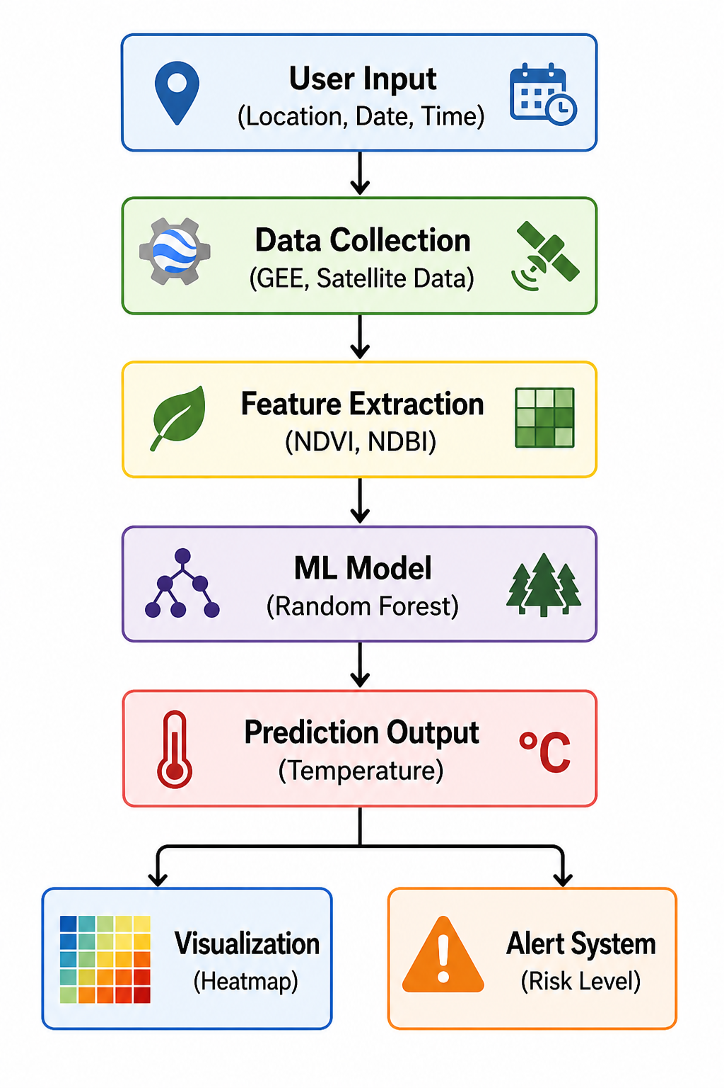
System Architecture

Slide 14
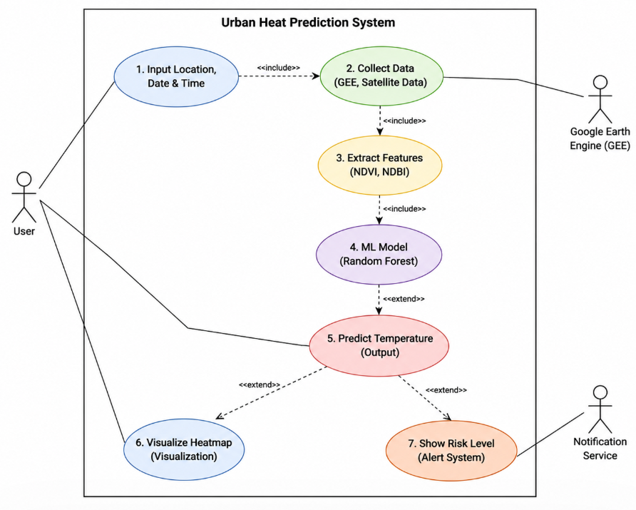
Usecase Diagram

Slide 15
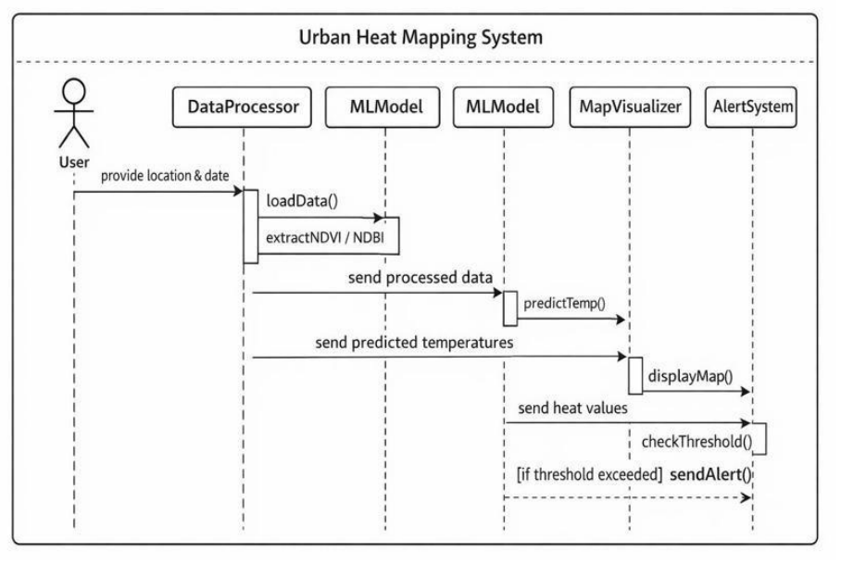
Sequence diagram

Slide 16
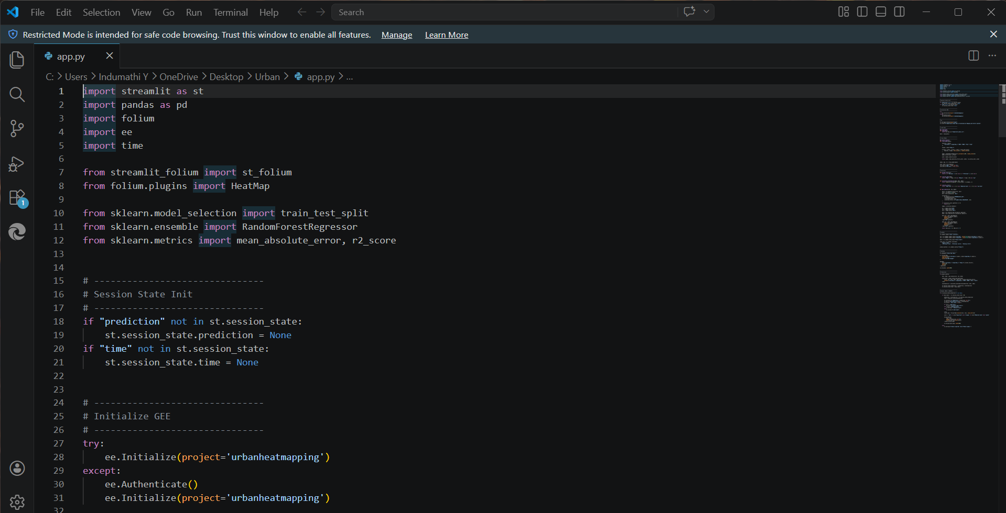
Code

Slide 17
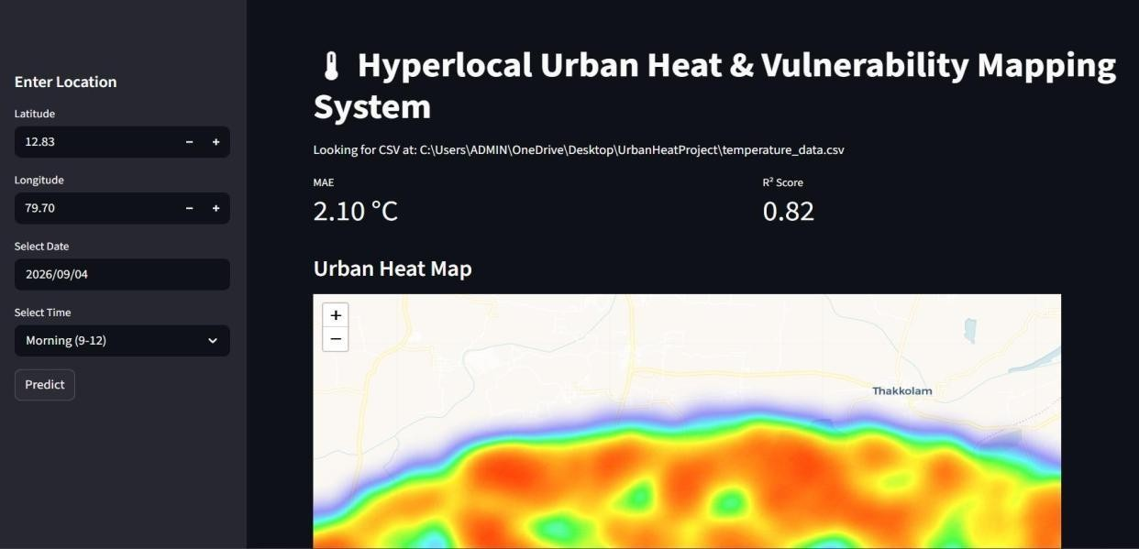
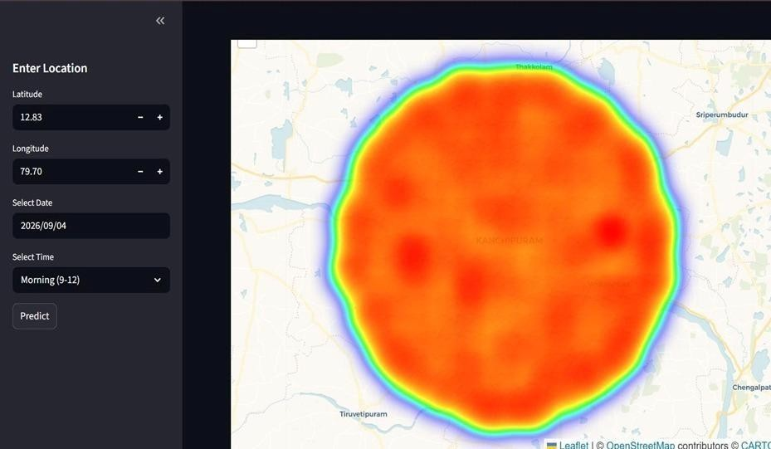
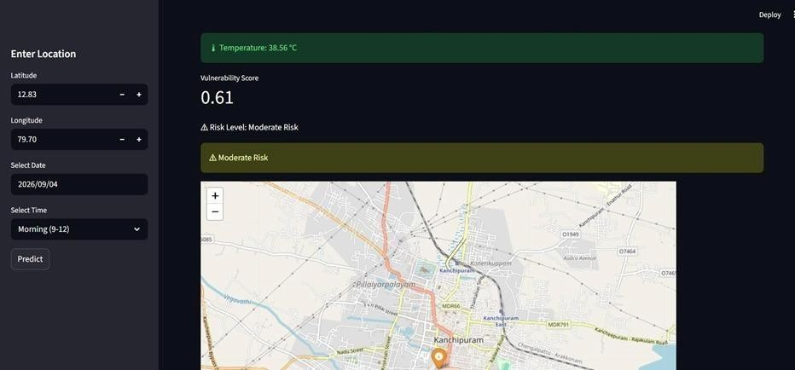
Output

Slide 18
The Project is Intended to
1. Heat Mapping System (Primary Use Case)
Analyzes temperature at a local (hyperlocal) level
Uses satellite data for accurate heat analysis
Identifies heat hotspot areas in the city
Displays results using heatmaps
Helps in easy understanding of temperature variations
2. Temperature Prediction & Alert System
Predicts temperature using Machine Learning (Random Forest)
Considers location and time (morning, afternoon, evening)
Calculates risk levels based on temperature
Generates alerts for high heat conditions
Helps users take preventive actions
Key Strength:
Combines heat analysis + prediction + alert system
Provides real-time and accurate results
Useful for daily monitoring and decision making
Supports urban planning and public safety

Slide 19
Experimental Results and Discussion
1. Temperature Prediction Results
The model predicts temperature using location and time inputs
Uses Random Forest algorithm for better accuracy
Shows reliable results for different areas and time periods
Error is measured using MAE (Mean Absolute Error)
2. Heatmap Visualization Results
Generated heatmaps clearly show temperature distribution
Hotspot areas are easily identified
Visualization helps in quick analysis and decision making
Works effectively for different locations
3. Time-Based Analysis
System analyzes temperature for morning, afternoon, evening
Shows variation of heat throughout the day
Improves prediction accuracy by including time factor

Slide 20
4. Alert System Performance
Alerts are generated based on temperature threshold
Classified into Normal, Warning, Critical levels
Helps users to take preventive actions
Works correctly for high-temperature conditions
Key Discussion:
The system provides accurate and efficient heat analysis
Combines prediction, visualization, and alert system
Overcomes limitations of existing systems
Useful for urban planning and public safety

Slide 21
Conclusion & Future Scope
CONCLUSION
The project successfully develops a system to analyze urban heat at a local level. It uses satellite data and machine learning to predict temperature accurately. The system identifies heat hotspot areas and displays them using heatmaps. It also provides alerts when temperature levels are high. The inclusion of time-based analysis improves the accuracy of prediction. Overall, the system is useful for monitoring heat conditions and supports urban planning and public safety.
FUTURE SCOPE
Add real-time data integration for better accuracy
Use advanced machine learning or deep learning models
Develop a mobile application for easy access
Integrate IoT sensors for live temperature monitoring
Expand system to cover larger regions or multiple cities
Add features like air quality and pollution analysis

Slide 22
References
[1] F. Larroya et al., “Hyperlocal Urban Heat Mapping using High-Resolution Satellite Data,” Remote Sensing Applications, 2025.
[2] IEEE Access, “Machine Learning Techniques for Urban Heat Island Analysis,” IEEE Access Journal, 2023.
[3] World Health Organization (WHO), “Heatwaves and Health: Guidance on Warning Systems and Action Plans,” WHO Report, 2023.
[4] P. Siddiqui et al., “Urban Heat Vulnerability Mapping using GIS and Remote Sensing,” Environmental Monitoring and Assessment, 2022.
[5] S. C. Sheridan and L. S. Kalkstein, “Development of Heat Vulnerability Index for Urban Areas,” Climate Research Journal, 2022.
[6] NASA, “Land Surface Temperature Data from Landsat Missions,” NASA Earth Observatory, 2023.
[7] Google Earth Engine Team, “Google Earth Engine: Planetary-Scale Geospatial Analysis Platform,” 2024.
[8] J. Breiman, “Random Forests,” Machine Learning Journal, vol. 45, no. 1, pp. 5–32, 2001.
[9] US Environmental Protection Agency (EPA), “Urban Heat Island Basics,” EPA Report, 2023.
[10] United Nations, “Climate Change and Urban Heat Impacts,” UN Environment Programme, 2024.

Slide 23
Thank You

